Slide 1

Agenda
What’s Apache Kylin?
Architecture Overview
The Magic
Benchmark: Vs Other Solutions
Benchmark (SSB)
Version History
Support

Slide 2
Introduction
Extreme OLAP Engine for Big Data
Kylin is an open source Distributed Analytics Engine from eBay that provides SQL interface and multi-dimensional analysis (OLAP) on Hadoop supporting extremely large datasets
History
2013 – Ebay start as internal project
Nov 2014 -- Apache Incubator Project
Nov 2015 --Apache Top Level Project

Slide 3

About me:
Alberto Ramon Portoles
Apache Kylin Committer
working with Hadoop from 2014 as Big Data Engineer / Administrator
Currently working in UK for a large multinational bank
Certified by Cloudera as
Hadoop Administrator (CCAH) in CDH4 & CDH5
HBase specialist (CCSHB)
Microsoft MS SQL Server Administrator and Developer(MCITP)
!! Thanks to all Apache Commiters !!

Slide 4
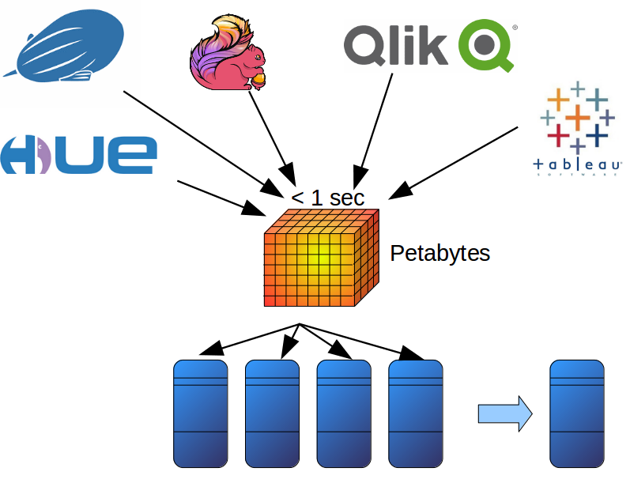
What’s Kylin?
Targets of Apache Kylin
Sub second query latency of billons of rows
Integration with most popular BI tools using standard SQL
Support for dimension with Ultra High Cardinality
Scalability horizontal Petabytes
Notes:
Sub second query latency of billons of rows
Integration with most popular BI tools using standard SQL
Support for dimension with Ultra High Cardinality
Scalability horizontal Petabytes

Slide 5
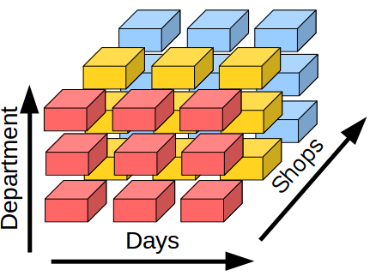
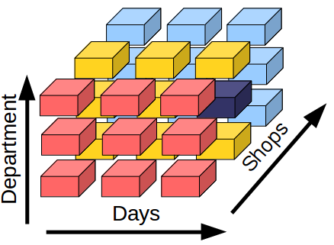
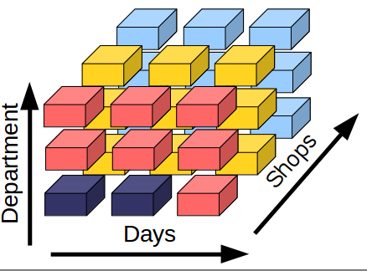
How does a cube work?
Sales Cube:
Sales for 1 Day & 1 Department & 1 Shop?
How many IOs?
Sales for 2 Day & 1 Department & 1 Shop?
How many IOs?
These IOS are sequential or Random?

Slide 6
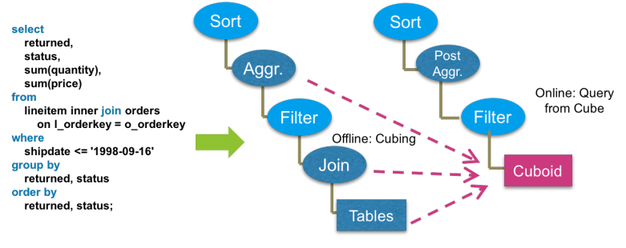
The Magic
Precalculation

Slide 7






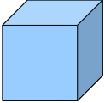




Architecture Overview
BI
Tools
Data
Commands
SQL
Source
DWH
Engine
Store
Pluging
Pluging
Pluging
Notes:
A High Level Architecture for Kylin which is a Standard MOLAP Architecture built on Hadoop.
Data Sources to build your MOLAP Cubes primarily Hive, We have a fantastic project in the works for a Storage Abstraction Layer and support other NoSQL Stores such as Cassandra/CouchBase.
An Engine Abstraction which maintains the Cube Metadata and a Cube Builder. Today a set of Map Reduce Jobs to build the cubes.
A storage layer to store the Cubes in Hbase, primarily through a Bulk Load of the aggregrates into Hbase.
We are looking for active community participation to build out additional Data Source, Engine and Storage plugins into Kylin.
A Query Engine that directly index into the multi-dimensional arrays built into Hbase.

Slide 8
Benchmark: Vs Other Solutions
Reference: Kylin TCPH

Slide 9
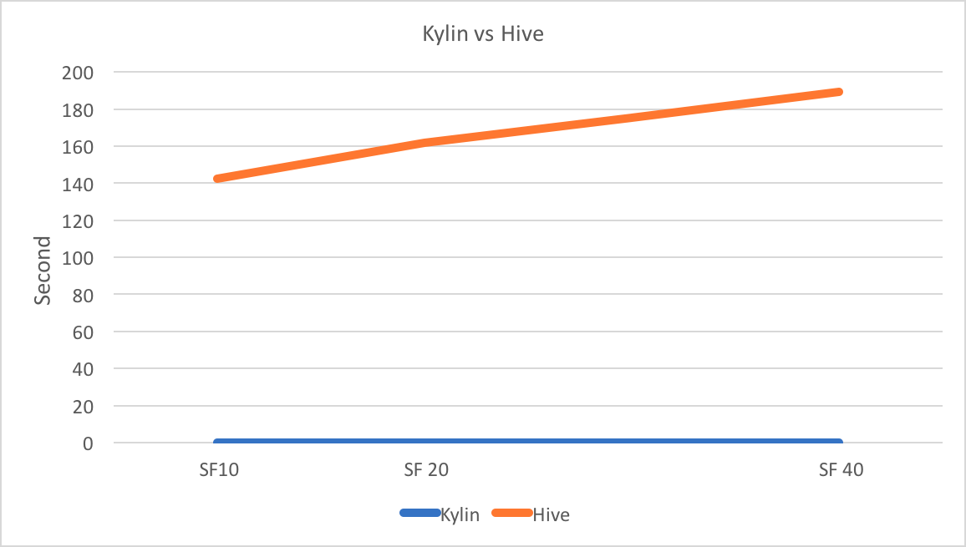
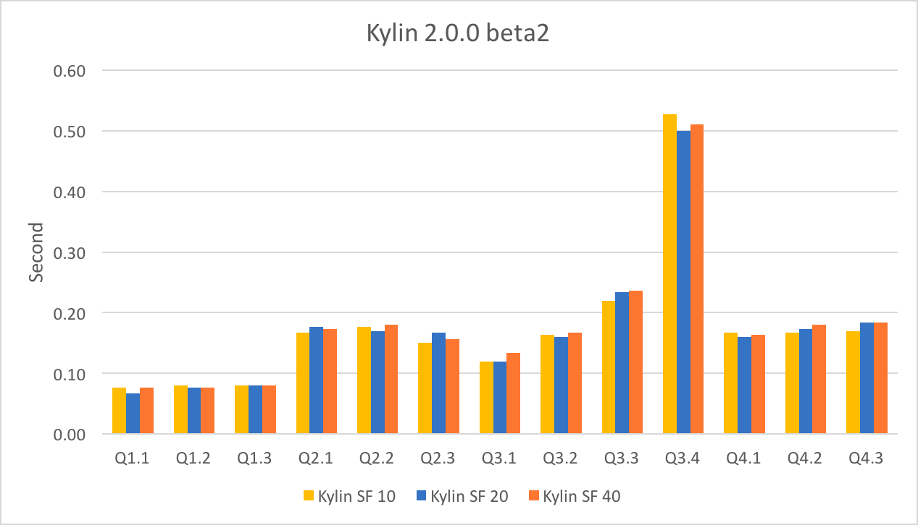

Benchmarks (SSB)
Reference: Kylin SSB
SSB is a modification of TPC-H (Start schema Benchmark)
With Apache Kylin:
Most response time < 1 sec
Independent of cube size
Independent of data read
Resolves queries using fewer hardware resources
Most of response time are latencies
Can somebody can see some unusual ?
Response time:
Kylin: O(1)
Hive: O(N)
Good performance Independent of:
Numbers of users
Over time

Slide 10
To Streaming
Version History
Administration
Performance, New funct.
0.7.1 -1.3
1.5
1.6
2.0
Inverted Index NRT v1
Kafka (experimental)
Fast Cube Algorithm
Kafka (NRT v2)
Streaming Cube (NRT v2)
Spark (experimental)
Spark Cubing (NRT v2)
Layer on Spark
Support Kerberos
ACLs
Plugging Architecture
Hybrid Model
JMX Metrics
Separate HBase & HA & Kerberos
Amazon EMR
Support MapR
Azure HDInsight
Snowflake DM
Job Engine HA (100% HA)
Custom Aggr Types
Cube Retention
Incremental Build
Parallel Scan
TopN: Exactly
Stream
Percentile
Joint Rules
TopN: Approx, UHC
Count Distinct: Approx Exactly
Windows Functions
Grouping Sets
Global Dictionary
NRT
Experimental (NRT)
Batch

Slide 11

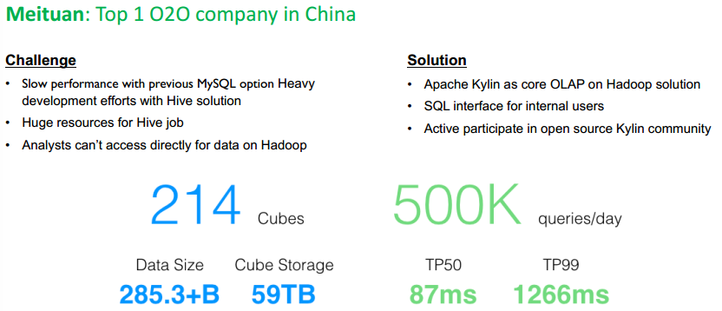
Use Cases

Slide 12

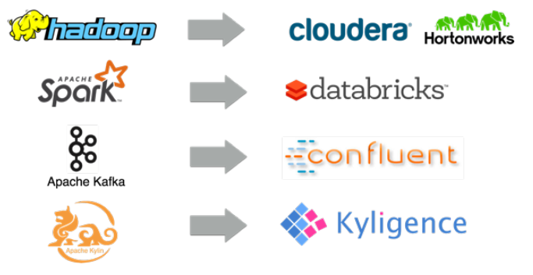
Support
Formed by the team who created
Apache Kylin
Founding from Redpoint Ventures,
CBC and Shuwei Capital
Offers support and training
Notes:
A High Level Architecture for Kylin which is a Standard MOLAP Architecture built on Hadoop.
Data Sources to build your MOLAP Cubes primarily Hive, We have a fantastic project in the works for a Storage Abstraction Layer and support other NoSQL Stores such as Cassandra/CouchBase.
An Engine Abstraction which maintains the Cube Metadata and a Cube Builder. Today a set of Map Reduce Jobs to build the cubes.
A storage layer to store the Cubes in Hbase, primarily through a Bulk Load of the aggregrates into Hbase.
We are looking for active community participation to build out additional Data Source, Engine and Storage plugins into Kylin.
A Query Engine that directly index into the multi-dimensional arrays built into Hbase.

Slide 13

Thanks!
http://kylin.apache.org
https://github.com/apache/kylin
https://github.com/albertoRamon/
https://www.linkedin.com/in/alberto-ramon-portoles/

